Slide 1
FRONTEND PROJECT
ANYTHING.COM
INSTRUCTOR:MR.LAVISH ARORA
Aaryan Prabhakar | 2110990018 | G5

Slide 2

Table of contents
01
02
03
04
05
06
Introduction
Why Choose Us?
Goals
Challenges
Screenshots
Future Scope

Slide 3
01
Introduction

Slide 4

Introduction
ANYTHING.COM,is an e-commerce website that is revolutionizing the way people shop online. In a world that's becoming increasingly digital, ANYTHING.COM is your go-to destination for an unmatched shopping experience.We are a digital marketplace where endless possibilities meet your desires.

Slide 5
02
Why Choose Us?

Slide 6

Why Choose Us?
Why should you choose ANYTHING.COM over other e-commerce websites? Here are a few compelling reasons:
Personalization
Great Deals
Fast and Reliable Shipping
User Reviews and Ratings

Slide 7
03
Goals

Slide 8

Goals
Increase Web Traffic
Boost Conversion Rate
Expand Product Catalog
Enhance User Experience
Customer Support Excellence

Slide 9
04
Challenges

Slide 10

Challenges:
Load Speed
Shopping cart and checkout
UI/UX consistency
Peformance Optimization
Content Presentation

Slide 11
05
Screenshots

Slide 12
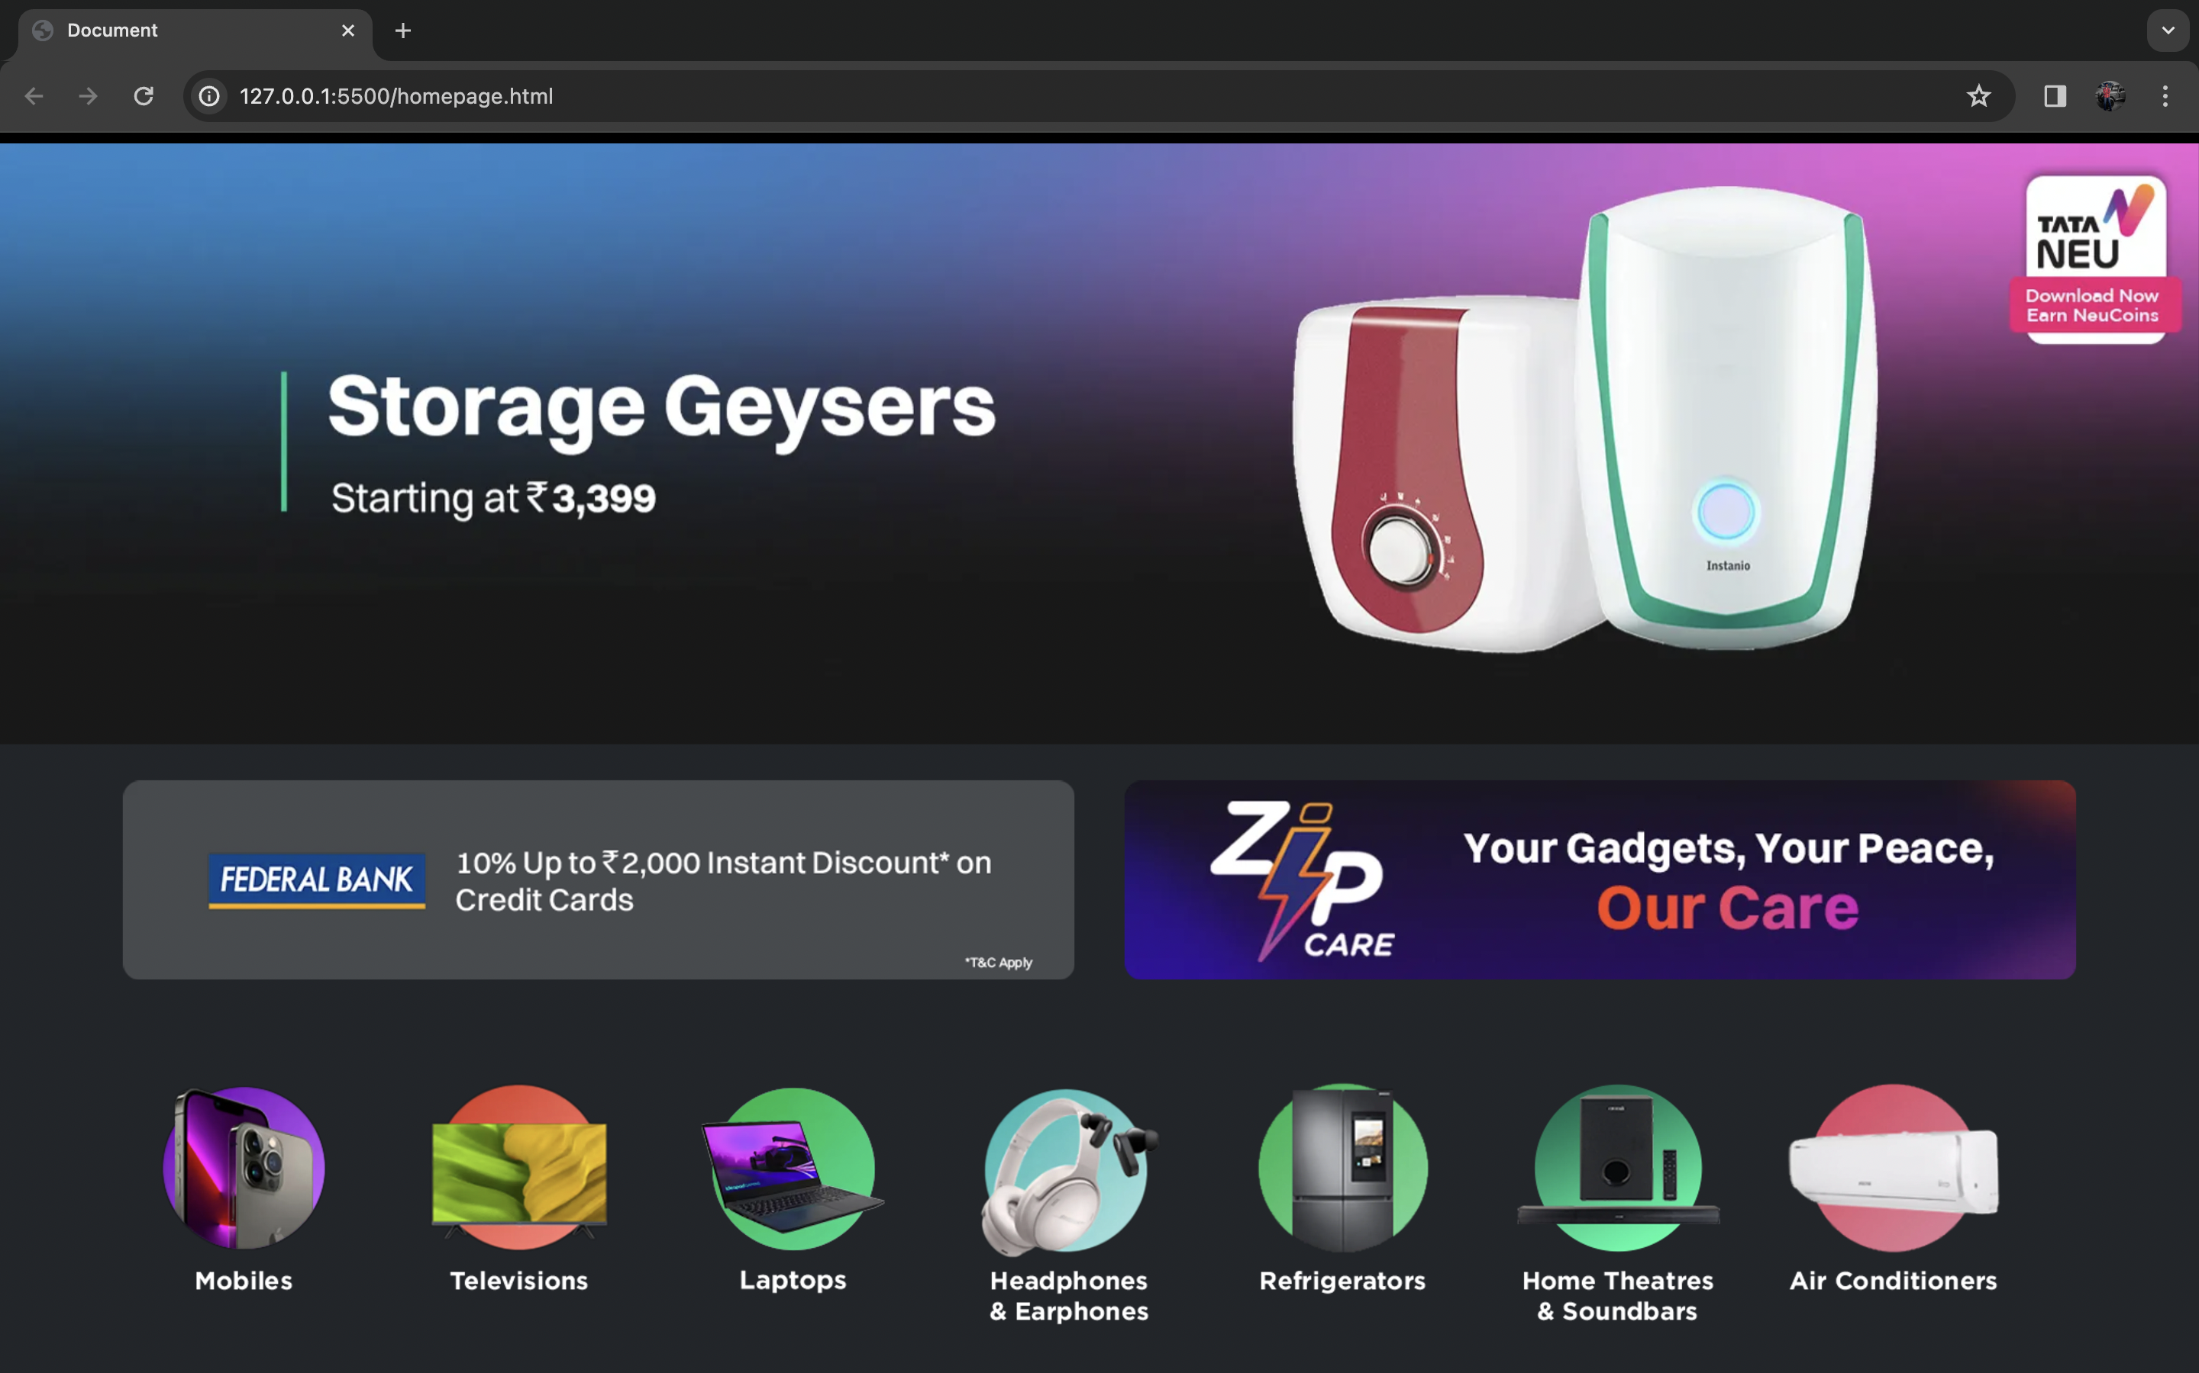
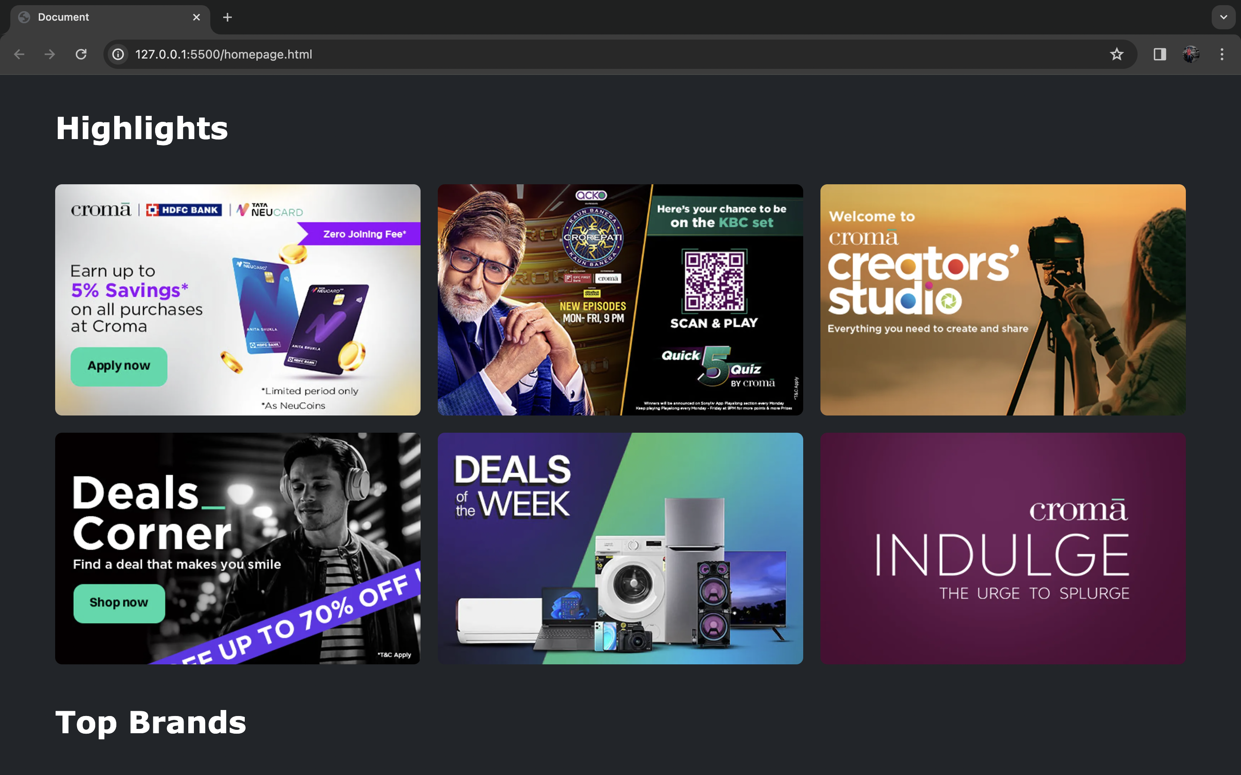
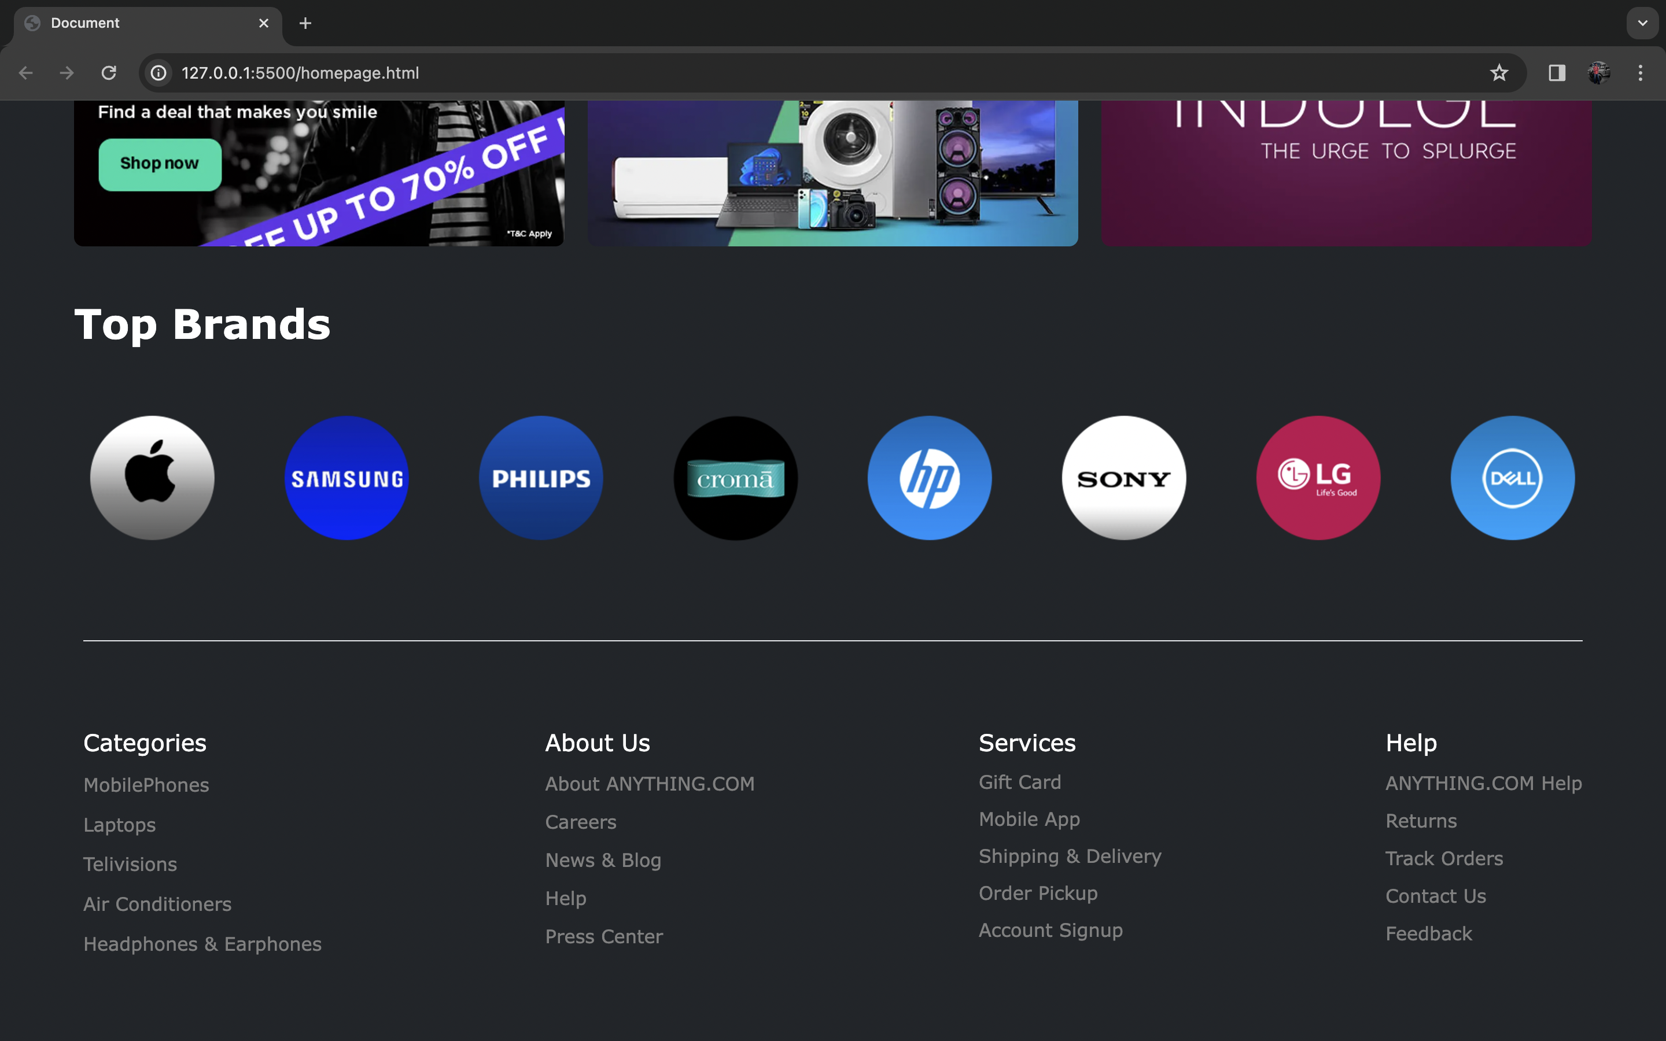
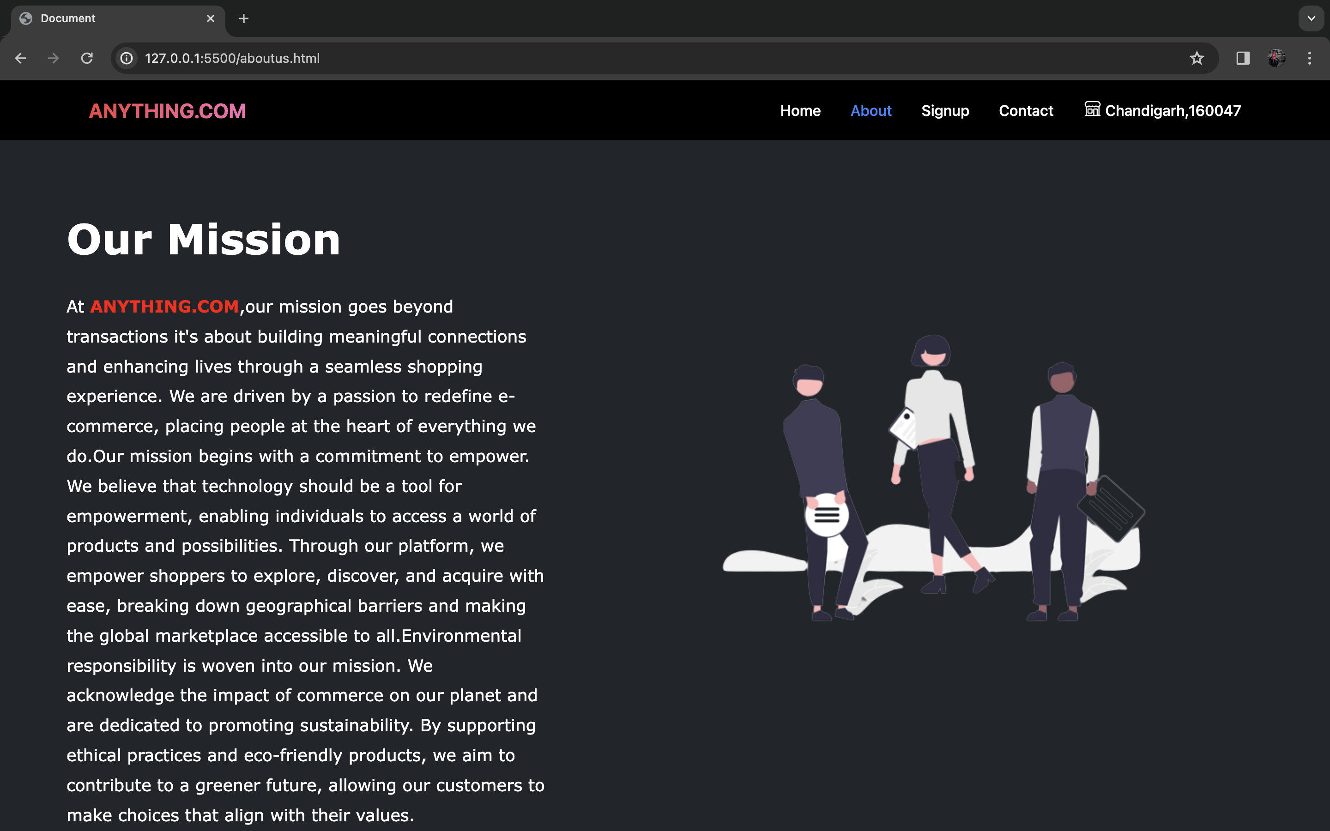

Slide 13
06
Future Scope

Slide 14

Future Plans:
Mobile App
Augmented Reality (AR) Shopping
Sustainability
Community Building

Slide 15
Thank You

